Slide 1
E-Commerce Data Analysis with TaoBao Users’ Behaviors --Data Mining Final Project
Team Students: Jiang Yuchen, Li Yuanzhao, Chen Jiyuan, Shang Jihao

Slide 2

Outline
Topic preview
Task Design and Experiment Result
III. Summary

Slide 3
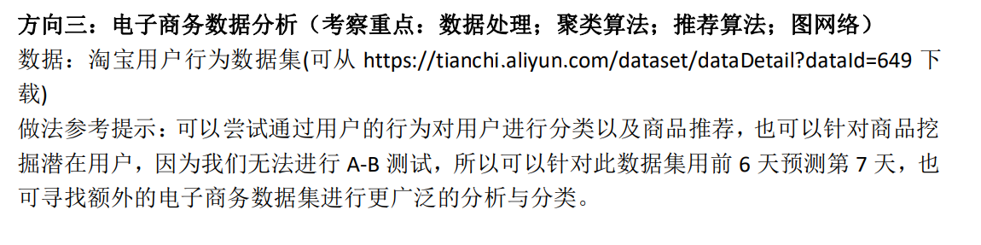
I. Topic Preview
First, our team members looked through all topics together with their datasets described in document.
Then, we reached an agreement that topic 3 will be chosen as final project’s topic.
Since we have done the literature review on this topic several weeks ago, we are familiar with it.
Figure.1 Topic 3 Description

Slide 4
II. Task Design
We decide to start our project with three aspects
First, analyze data, extract some basic information and do analysis based on RFM model.
Second, analyze data, build up users’ behavior matrix and apply Non-negative Matrix Factorization(NMF) to it in order to find out the potential user toward certain item.
Third, find out the most popular categories/commodities and do correlation analysis for bundling sales using FP-Growth algorithm.

Slide 5

Task1

Slide 6
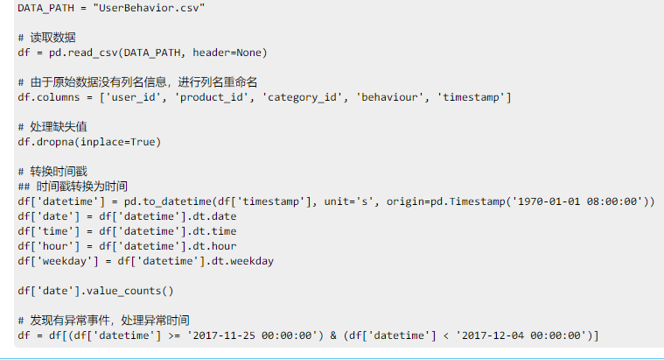
II. Task Design
Task1
Step1 perform data pre-processing
Read data from csv
Drop inappropriate data
Add header information to the benefit of the following actions
Figure.2 Perform Data Pre-processing

Slide 7
II. Task Design
Task1
Step2 analyze overall situation of user shopping
PV, UV, PV per user
Lost rate: the number of user that only click links / UV

Slide 8
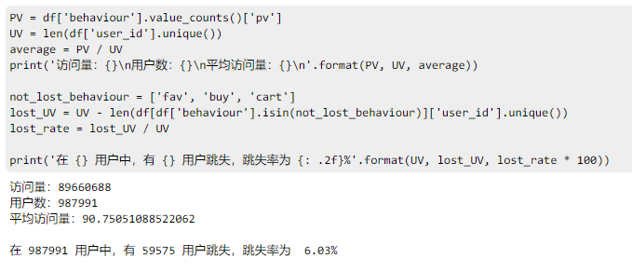
II. Experiment
Task 1:
平均访问情况和跳失情况良好
Figure.3 Result

Slide 9
II. Task Design
Task1
Step3 analyze the user behavior
Daily page view analysis
Weekly page view analysis
Trading volume in one day

Slide 10
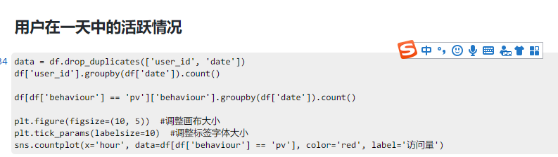
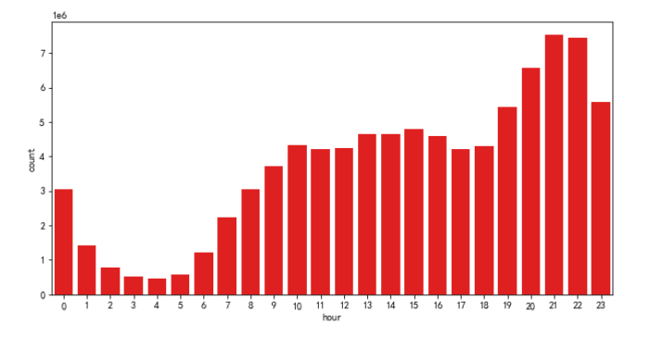
II. Experiment
Task 1:
在 21~22 点最为活跃
Figure.4 Result

Slide 11
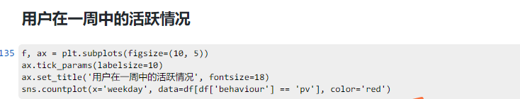
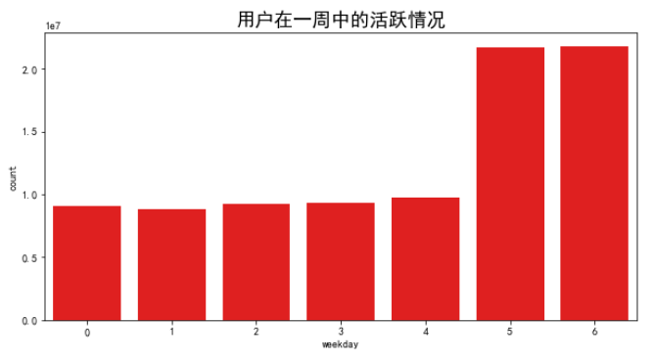
II. Experiment
Task 1:
周末最为活跃
可以根据数据调整服务器参数，实现用户体验和收益的平衡
Figure.5 Result

Slide 12
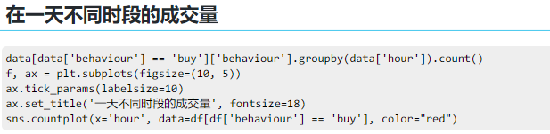
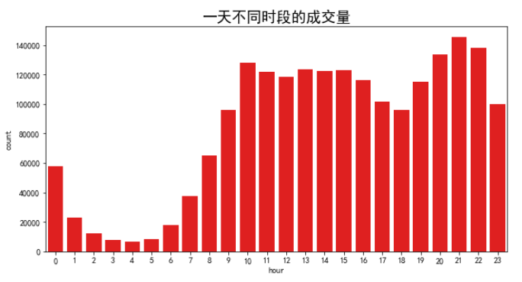
II. Experiment
Task 1:
一天中 21~22 点成交量最大
可以根据成交量数据对物流的资源分配进行调整，提升用户体验
Figure.6 Result

Slide 13
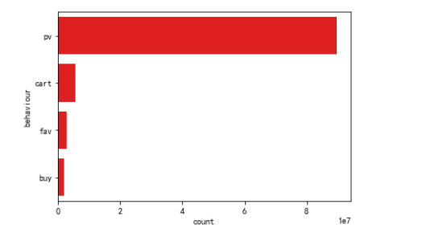
II. Task Design
Task1
Step4 analyze the user behavior conversion model
Browse to cart
Browse to favor
Favor to buy
Figure.7 Behavior count

Slide 14
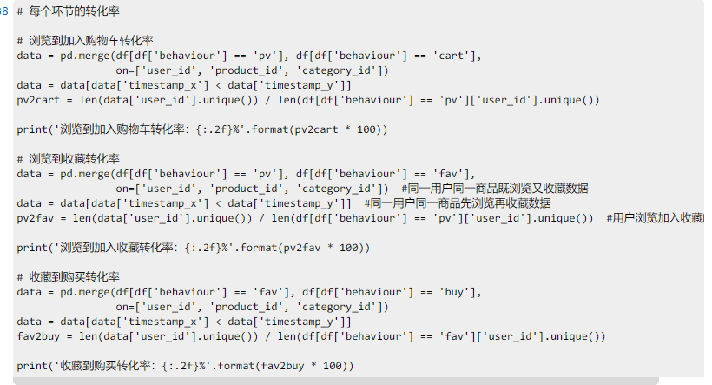
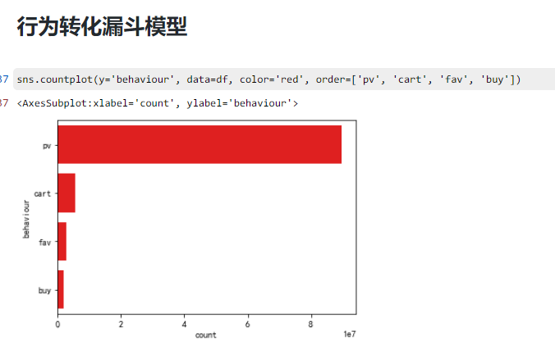

II. Experiment
Task 1:
可以看出浏览到加入收藏相比于加入购物车少很多，同时收藏到购买的转化率也不高，可以考虑对收藏功能进行优化
Figure.8 Result

Slide 15
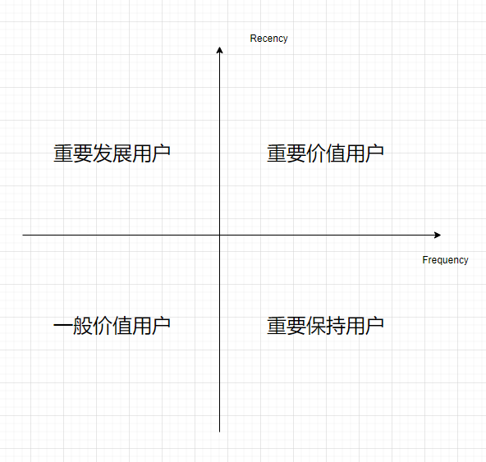
II. Task Design
Task1
Step5 analyze based on RFM model
R: Recency purchase behavior, F: Frequency of purchase, M: Money spent
Only analyze R and F because there is no M information
Divide user into different level, use average level as a standard
Figure.9 User division

Slide 16
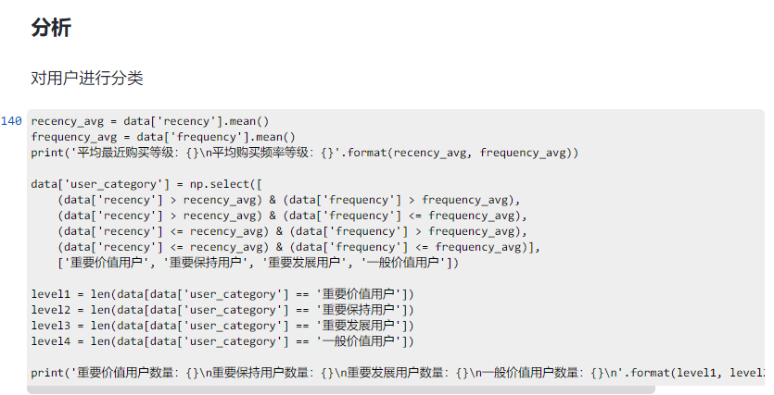
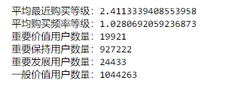
II. Experiment
Task 1:
可以看出一般价值用户和重要保持用户占多数，可以根据用户的类型对用户进行个性化推送
Figure.10 Statistics

Slide 17
II. Task Design
Task1
Step6 Collaborative Filtering
UserCF
ItemCF
Evaluate

Slide 18
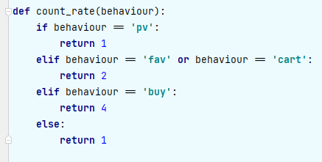
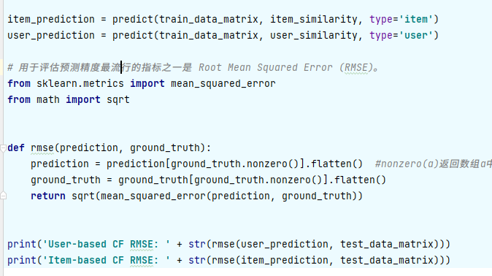

II. Experiment
Task 1:
Figure.11 Core codes

Slide 19
Task2

Slide 20
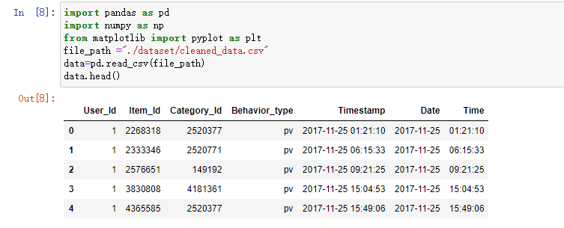
II. Task Design
For task 2, we also do data clean first, which drop duplicate data and unreasonable data.
We save cleaned data so that it can be taken into use quickly.
Figure.12 Cleaned data

Slide 21
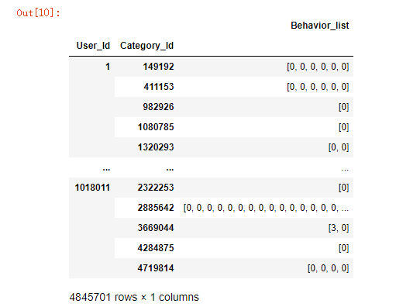
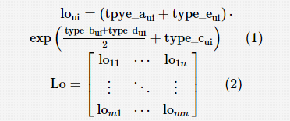

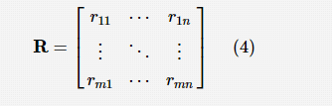
II. Task Design
Then, we contruct the dataframe group by User_id and Category_id.After that, we fill in the m*n matrix(m represents users, n represents items) with the information shown right.
Figure. Behaviors Dataframe
Figure.13 Equation for Matrix Content

Slide 22
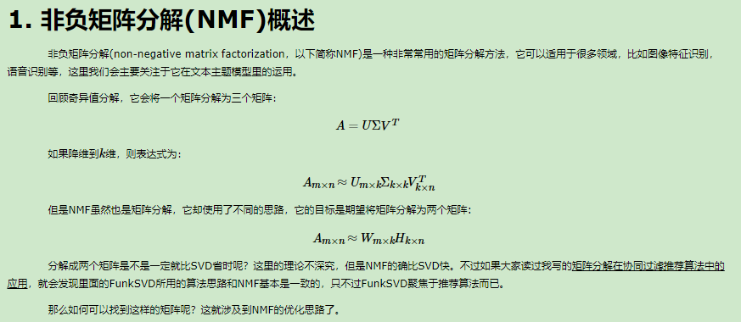
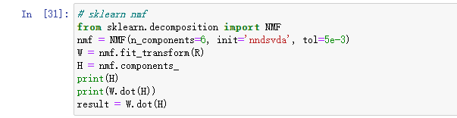
II. Task Design
Then, apply NMF to the matrix.For matrix R, we want to decomposite it into W(user feature matrix)and H(item feature matrix) matrix. However, the product of W and H is different from original R.Thus, we need to minimize the difference.
Figure. NMF definition
Figure.14 Sklearn NMF method

Slide 23
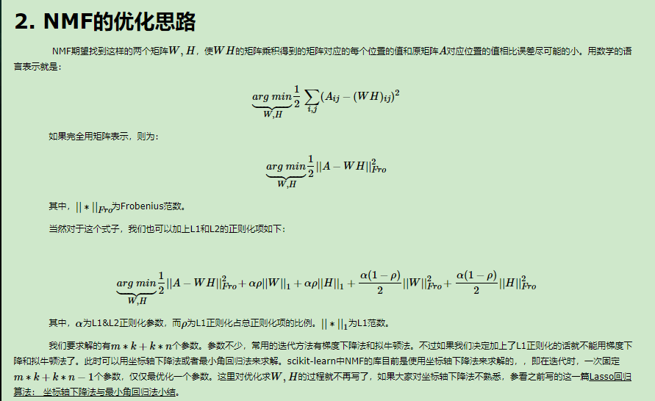
II. Task Design
NMF provides such function. So we apply sklearn.decomposition.NMF() to matrix R and get the result.
Figure.15 Sklearn NMF optimization

Slide 24
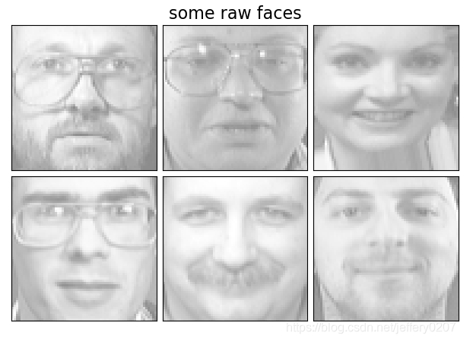
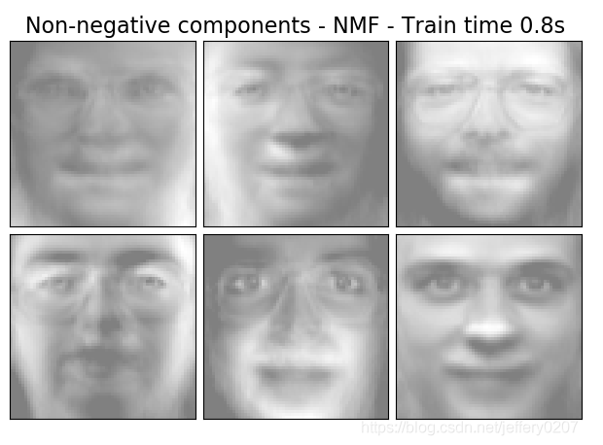
II. Task Design
Reality usage:
According to current behaviors, we can judge whether the user is interested in other items which doesn’t have interaction with users.
Potiential Coefficient
Figure.16 Reality usage of NMF in CV

Slide 25
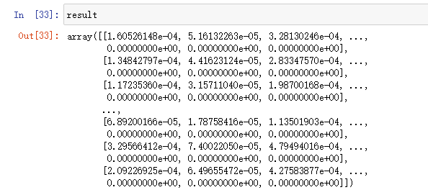
II. Experiment
Task 2:
198000 * 8562 Matrix
The content [x,y] is Potiential Coefficient for user x with item y
(If we have real label for such Potiential Coefficient, we can train our model with parameters which I set on my own.)
Figure.17 Result Matrix

Slide 26
Task3

Slide 27
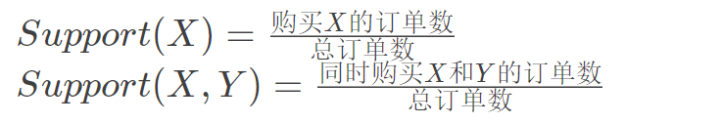
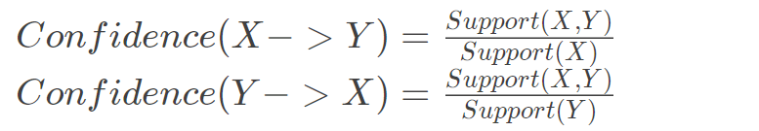
II. Task Design
Our goal is to figure out the most popular categories/commodities and do correlation analysis.
Example: Walmart puts beer and diapers together.
There're two famous correlation analysis algorithm: Apriori and FP-Growth. Both of them return the the largest frequent set of K items (最大频繁K项集). Then with the result we can generate correlation relationships based on Support(支持度), Confidence(置信度) and Lift (提升度).
Here we choose FP-Growth because it only has to iterate the dataset twice, saving us a lot of time and space.
Figure.16 Reference equation

Slide 28
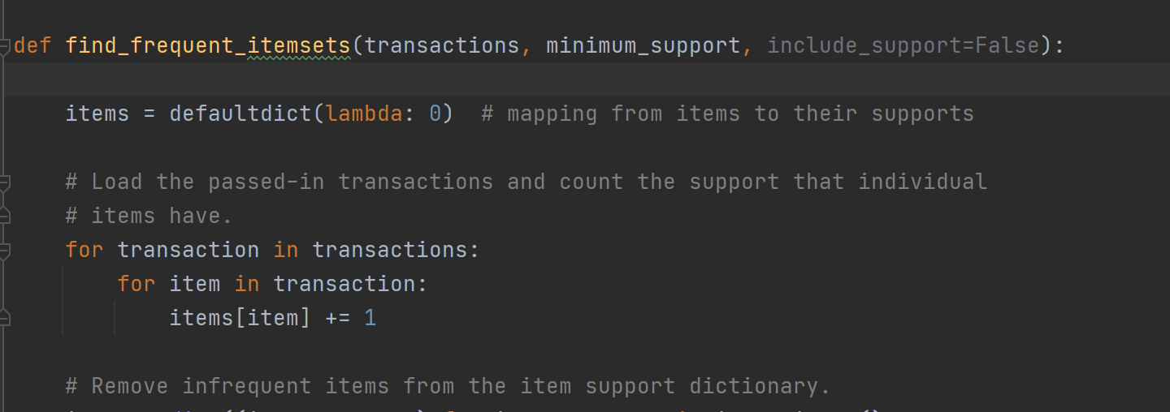
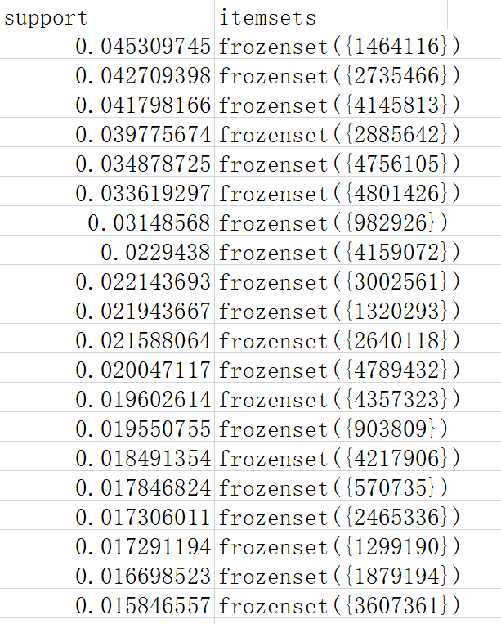
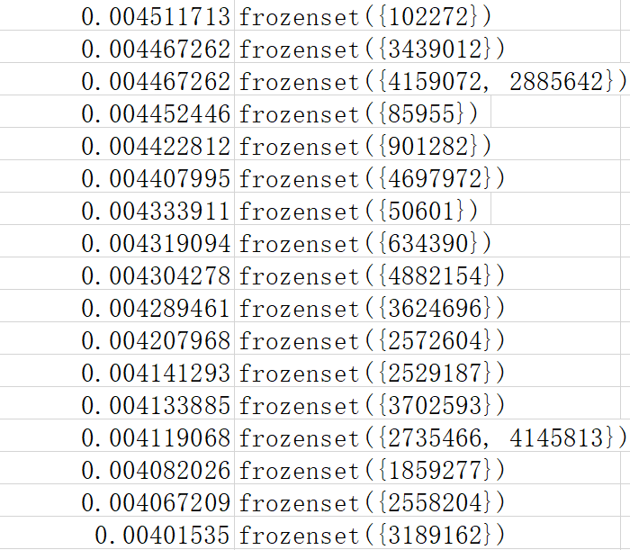
II. Task Design
The dataset is somehow too large, so we begin with analyzing each category instead of different commodities.
Implementation of FG-Growth algorithm
Category 1464116 and 2735466 is way more popular than other categories !
Figure.17 Dataset

Slide 29
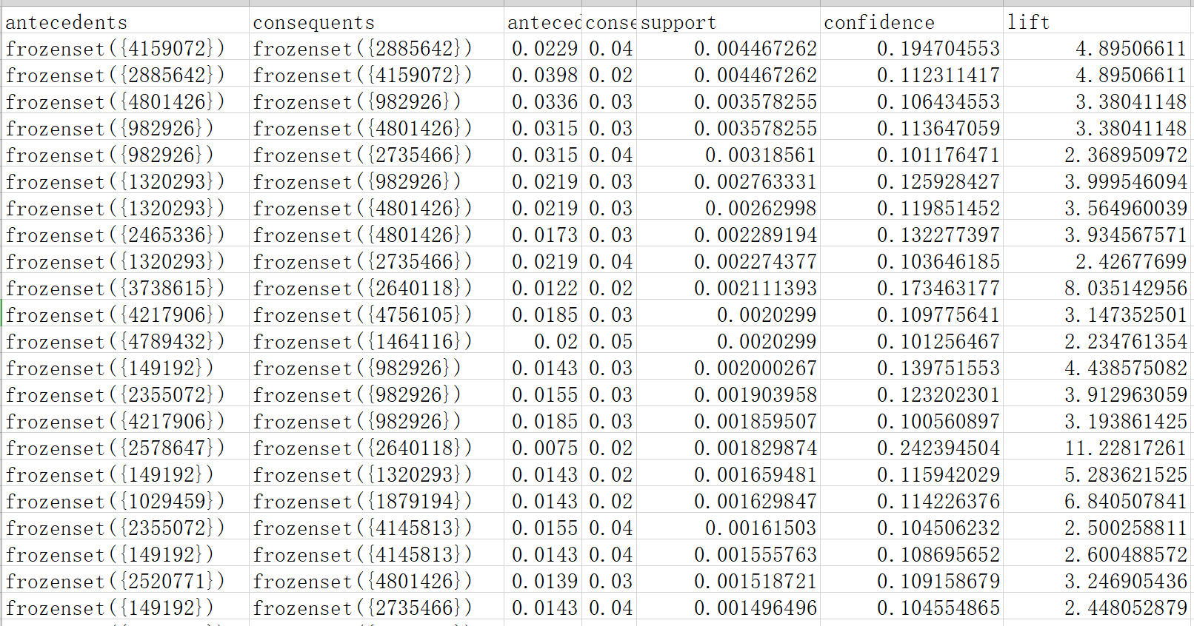
II. Experiment
The Support Parameter is a little bit low due to the large number of category of goods the platform sells.
The rows are sorted from high support to low support because we think higher support means the combination happens more frequently.
As we can see, category 4159072 and category 2885642 are often bought together and the lift = 4.895 > 3 means there are good positive relations between them
Figure.17 Transformed table

Slide 30
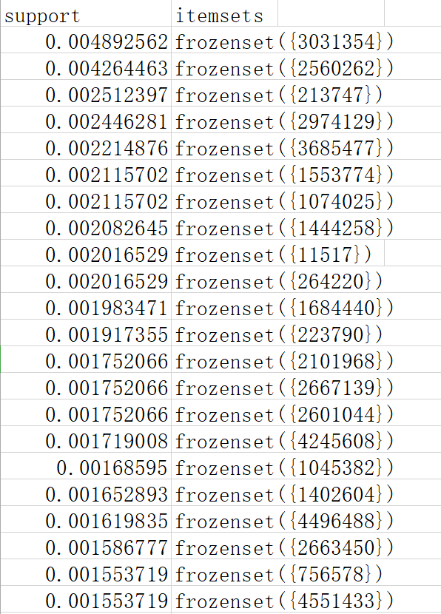
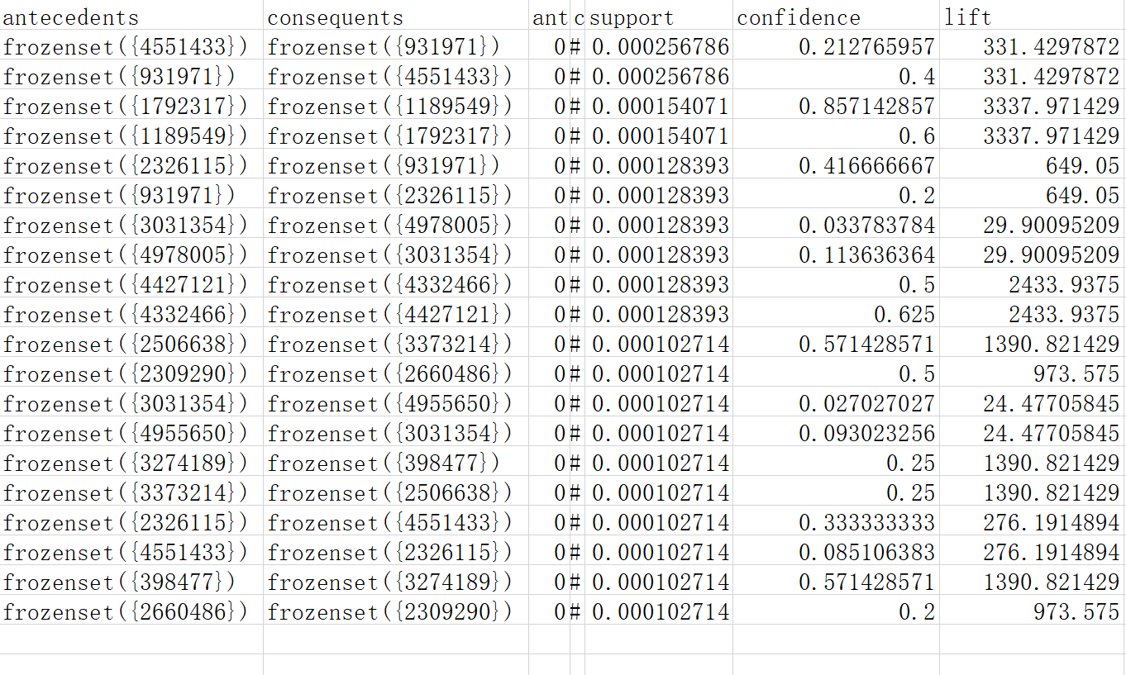
II. Experiment
Similarly, we choose the top 14 categories in association figure and looks into them to find out the relationship of commodities.
From the most-popular category figure, we choose top 7 popular categories and look into them to find the most-popular commodities.
Figure.17 Transformed table

Slide 31
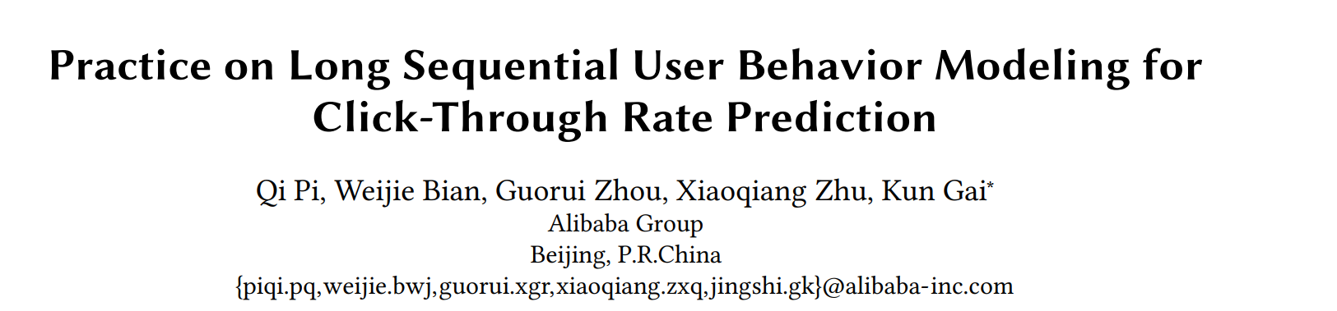
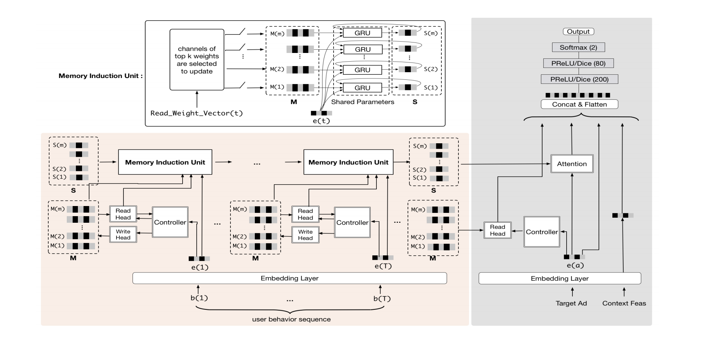
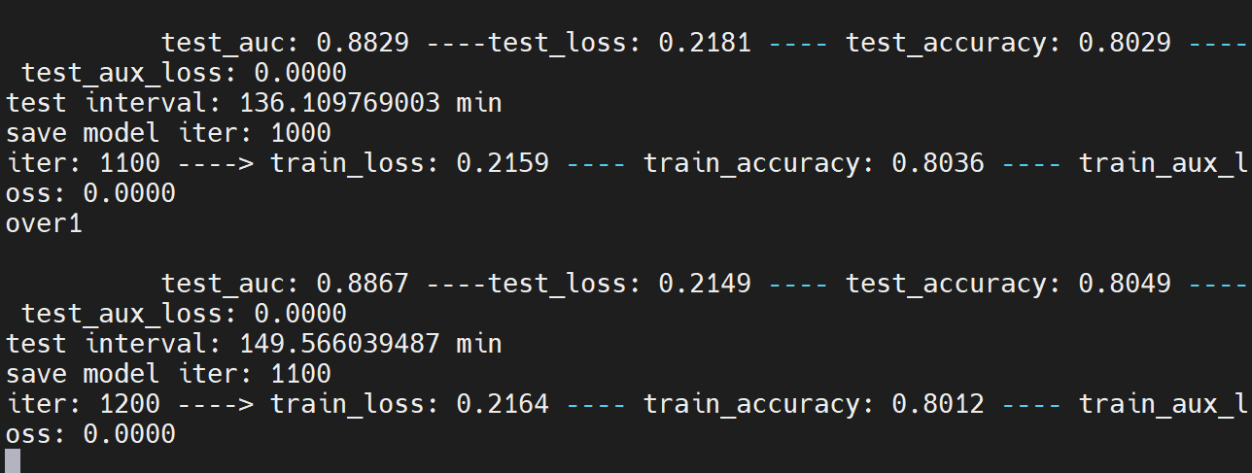
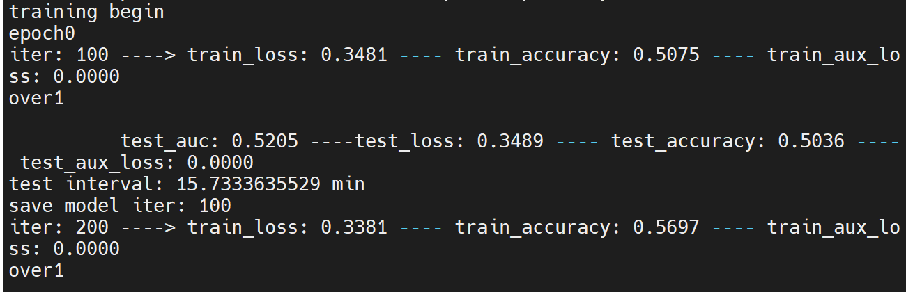
Extra Work
1. The latent space representing the interests of users can be updated on time according to the user behavior. WHY? Because it decouples the unit from the model to make it free for on time update.
2. The new memory unit can now capture user interests from long sequential behavior data. It is implemented in an incremental manner with UIC module. ADDing memory utilization regularization and memory induction unit.
Figure.18 Network

Slide 32

III. Summary
According to the given topic, we start our research in three aspects and one extra aspects. We get the meaningful results. All of them have their corresponding reality usage.
We realize that how data mining transforms raw data into meaning results.
Figure.19 E-Life

Slide 33
Thanks for watching！

